Slide 1
Group 5
CAPSTONE PROJECT
VIETNAMESE SIGN
LANGUAGE RECOGNITION

Slide 2

Introduction
Group member :
Nguyễn Hữu Kỳ Long – Team leader
Nguyễn Đình Tân – Team member
Nguyễn Xuân Ý – Team member
Lê Phương Bình – Team member
Supervisor :
Mr. Đỗ Đức Minh Quân

Slide 3
Outline
Scenario problem
Our solution
System feautures
System overview
Overview components
System processes
Future plan
Demo

Slide 4

Scenario problem
Dumb person must use other way to communicate, it is called hand sign language.
You are not able to get hand sign language.
Difference between hand sign languages.
Temporary solutions: handwriting, using familiar signs, translator ...

Slide 5


Our solution
A system plays a role as translator in communication.
Small device can capture hand signs via camera and then recognize them in text and sound with the same meaning.

Slide 6



System Features
Portable System
Hand Sign Language Recognition
Learning Hand Sign Language

Slide 7
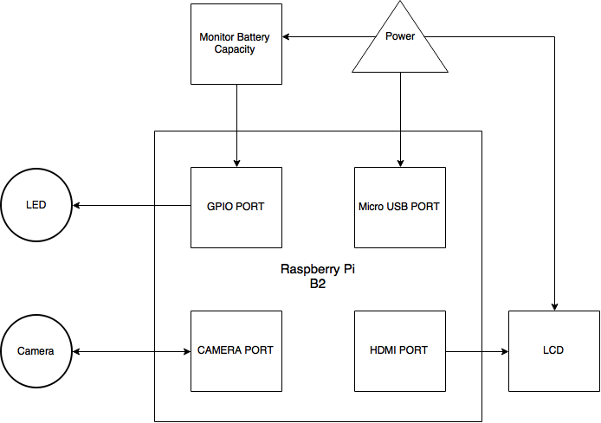

System overview

Slide 8
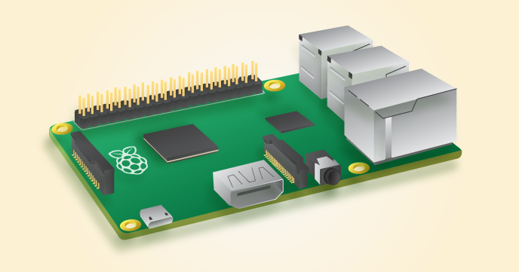

Overview components
Raspberry Pi B2
SoC: Broadcom 2836
CPU: Quad-core ARM7 800MHz
GPU: Videocore IV 250MHz
Memory: 1GB

Slide 9
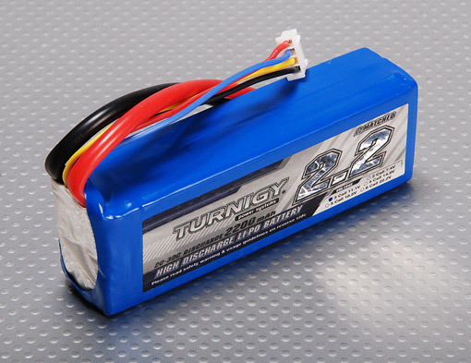

Overview components (Cont)
Lipo Battery
Minimum Capacity: 2200mAh (True 100% Capacity)
Configuration: 3S1P / 11.1v / 3Cell

Slide 10
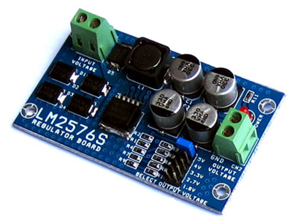
Overview components (Cont)
LM2576ADJ - 3A UNI REG Board
UNI-REG board allows changing voltages from 7-23V AC (or 9-32V DC) to 5V, 4V, 3.3V, 2.7V or 1.8V.
Circuit Board using LM2576 - Step-Down Voltage Regulator.
On-board screw-terminals are available for easy connection.
Notes:
Sử dung IC ổn áp LM2596S-ADJ
Điện áp đầu vào: 7-21 VAC hoặc 9-32 VDC
Điện áp đầu ra: 5.0V, 4.0V, 3.3V, 2.7V và 1.8V, Lựa chọn bằng Jumper
Dòng tải: max 3.0 Ampere
Board mạch 2 lớp chất lượng cao, dòng tải lớn
Kích thước board: 45 x 77 mm, có 4 lỗ 3.2 mm thuận lợi cho việc lắp đặt và cố định board
Có sẵn mạch chỉnh lưu cầu 4 Diode tốc độ cao, không cần phân biệt AC/DC và cực tính DC đầu vào

Slide 11
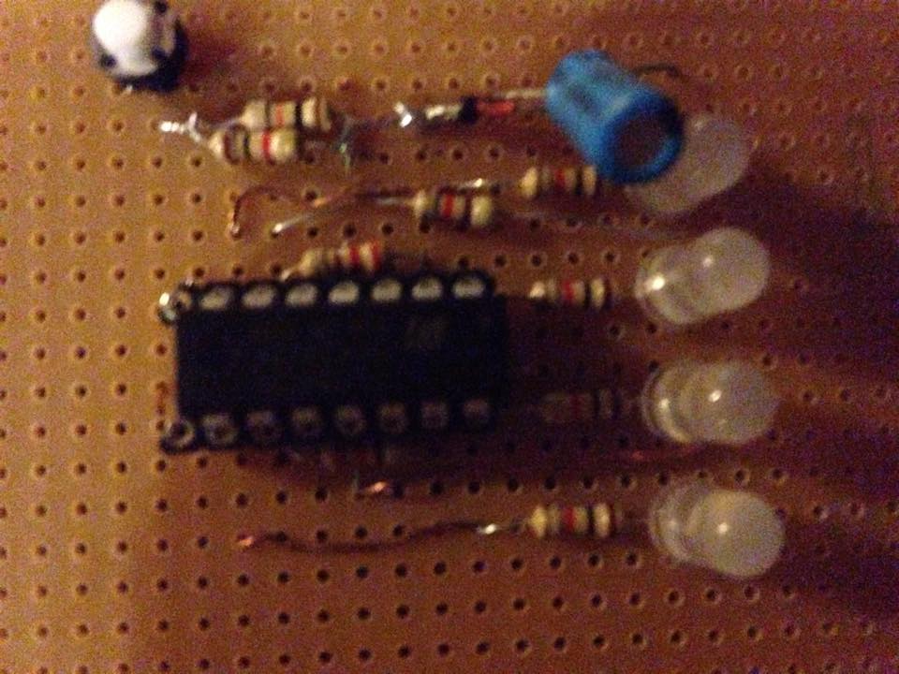

Overview components (Cont)
Circuit display the battery capacity via LED
LT084
1 diode zener 5.1v (1N4733)

Slide 12
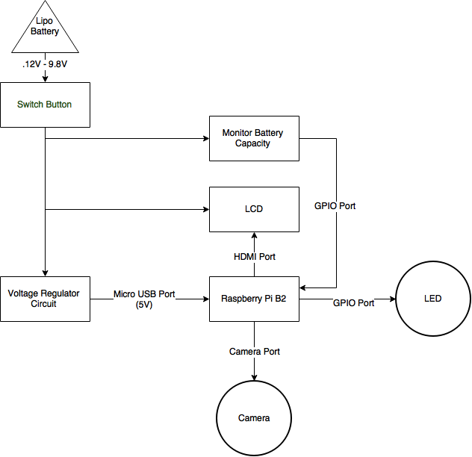
Overview components (Cont)
Connection components

Slide 13
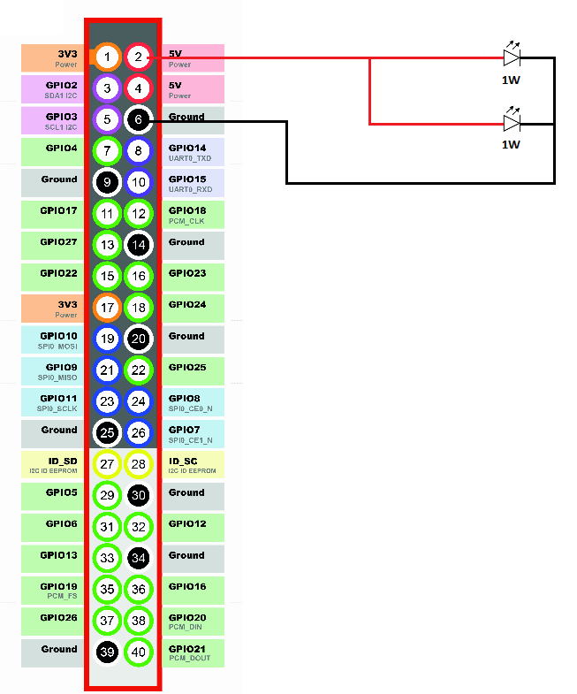
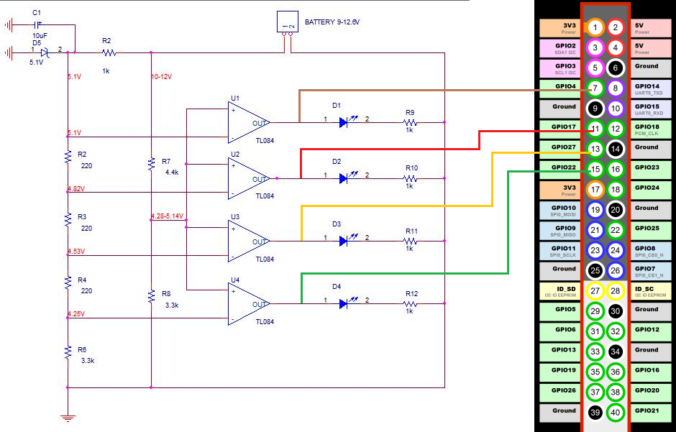
Overview components (Cont)
Connection components

Slide 14

System Processes
Hand Sign Recognition Process
Battery Capacity Notify Process

Slide 15

Hand Sign Recognition Process
Image Processing
Extract Features
Recognition by SVM
Output recognition result

Slide 16

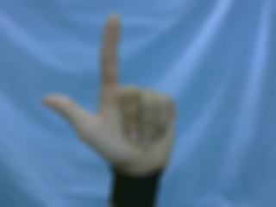



Hand Sign Recognition Process
Image processing

Slide 17
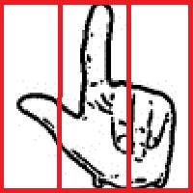
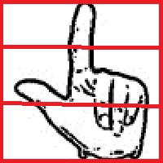
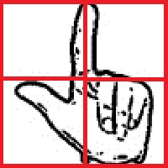

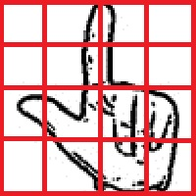
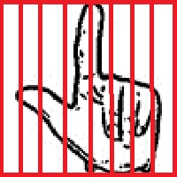


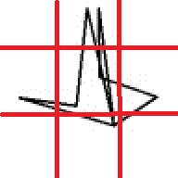
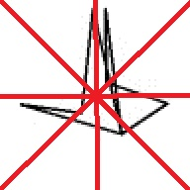
Hand Sign Recognition Process
Features Extraction

Slide 18
Hand Sign Recognition Process
Recognition by Support Vector Machine
Support Vector Machine is a useful technique for data classification that analyzes data and recognizes patterns.
Supported library: LIBSVM library
Produce a model by basing on the training hand sign feature data and then rely on the model to predict the target values of the other hand sign features.

Slide 19

Hand Sign Recognition Process
Output Recognition Result
Show text to LCD screen
Vocalize through the speakers lcd

Slide 20
Battery Capacity Notify Process
Receiving signals from Notify Battery Capacity Circuit
Display battery capacity in LCD
Show warning when low capacity.

Slide 21

Recognition experiment
Table. Percentage of accuracy of sample
 |  | Percent Of Accuracy
 | A | 100%
 | B | 100%
 | C | 100%
 | D | 100%
 | DD | 100%
 | E | 100%
 | G | 100%
 | H | 100%
 | I | 100%
 | K | 100%
 | L | 100%
 | M | 100%
 | N | 30%
 | O | 100%
 | P | 100%
 | Q | 100%
 | R | 100%
 | S | 100%
 | T | 100%
 | U | 100%
 | V | 100%
 | X | 100%
 | Y | 100%
 | backhand | 100%
 | SAC | 100%
 | HUYEN | 100%
 | RAU | 100%
 | MU | 100%
 | Total | 98%

Slide 22
Advantages and Disadvantages
Advantages
Quick and easy communicate for dumb person.
Train for person who don’t know about mute language.
People get used to the dumb language easily.
Disadvantages
This solution needs stable environment (light, background) and some accessories.
This solution can not solve the problem about hand motion language.
Standardized for hand sign language.
In some cases, this solution does not work really exactly with the hands have weird characterize.

Slide 23
Future plan
Recognize hand signs with motion
Manage hand sign language database
Improve the efficiency of the recognition of many different environments

Slide 24

Demo

